Slide 1
The Impact of Important Laws of Myanmar
on Foreign Parties to Offshore PSCs
James Finch, Partner
Southeast Asia Offshore Summit
9 September 2014

Slide 2
Outline of the Talk
1
Business Structure and Tax
2
Functions of Maritime Authorities
3
Foreign Vessels and Myanmar Waters
4
Environmental Framework and Marine Pollution
5
Labor Obligations

Slide 3
Outline of the Talk
1
Business Structure and Tax
2
Functions of Maritime Authorities
3
Foreign Vessels and Myanmar Waters
4
Environmental Framework and Marine Pollution
5
Labor Obligations

Slide 4
Accessing Opportunities in Myanmar – into Myanmar Waters
PSC operators (the parties that sign PSCs with MOGE) must do business under the FIL, which has a 5-year tax holiday and thereafter is subject to a 25% tax on net income.
Subcontractors to the above operators (for example, individuals or companies providing services to the operators) couldn't file under the FIL because they are providing services and this is not allowed by the MIC. Their income in Myanmar is subject to a 2% withholding tax if they have a company or branch in Myanmar and 3.5% if they don’t.
Double taxation agreements with: United Kingdom, Singapore, India, Malaysia, Vietnam, South Korea, Thailand and Laos.

Slide 5
Accessing Opportunities in Myanmar – Into Myanmar Waters
FIL Company [both PSC or subcontractor]
Special tax incentives:
Income tax exemption for a period of at least five (5) consecutive years including the year of commencement of business operation;
Income tax exemption or relief on profit accrued from the Project which are kept as a reserve fund for re-investment, and if re-invested therein within one (1) year;
Right to deduct depreciation from the profit, after computing it at rate stipulated by Myanmar, in respect of machinery, equipment, building or other capital assets used in the Project for the purpose of income-tax assessment;

Slide 6
Accessing Opportunities in Myanmar – Into Myanmar Waters cont’d
Special tax incentives cont’d
Right to pay income tax on the income of foreigners at the rates applicable to the citizens residing within Myanmar;
Right to deduct expenses from the assessable income incurred for research and development business which are actually required and are carried out within Myanmar;
Right to carry and set-off the loss actually sustained within two (2) consecutive years after the enjoyment of exemption or relief from income-tax as contained in sub-section i) above for each Project up to three (3) consecutive years from the year that the loss is sustained;

Slide 7
Accessing Opportunities in Myanmar – Into Myanmar Waters cont’d
Special tax incentives cont’d
Exemption or relief from customs duty or other internal taxes or both on machinery, equipment, instruments, machinery components, spare parts and materials used in the Project which are imported as they are actually required for use during the period of construction of the Project;
Exemption or relief from customs duty or other internal taxes or both on raw materials imported for production for the first three (3) years after the completion of construction of the Project;
If the volume of investment is increased with the approval of the MIC, and the original investment is expanded during the permitted period, exemption or relief from customs duty or other internal taxes or both on machineries, equipment, instruments, machinery components, spare parts and materials used in the business which are imported as they are actually required to use in the Project expanded as such, and
Exemption or relief from commercial tax on the goods produced for export.

Slide 8
Outline of the Talk
1
Business Structure and Tax
2
Functions of Maritime Authorities
3
Foreign Vessels and Myanmar Waters
4
Environmental Framework and Marine Pollution
5
Labor Obligations

Slide 9
Ports of Myanmar

Slide 10
Foreign vessel entering Myanmar waters Relevant Maritime authorities
Ministry of Transport
Law Amending the Myanmar Merchant Shipping Act, 2007
Myanma Port Authority
Department of Marine Administration

Slide 11
Maritime authorities
Myanma Port Authority
Shipping Agency Department

Slide 12
Functions of DMA
Inspection of the inland powered vessels (cargo, fishing and schooner) and providing penalty and fines for the vessels which contravened the rules and regulation as prescribed by ISV act.
Investigate when arising accident such as collision in water ways.
Recruitment and training of new seafarers and presented the certificates of competency, exemptions, clearance and out registrations .
The rights and welfare of seaman
Arranging bare boat charters to increase foreign currency earnings.

Slide 13
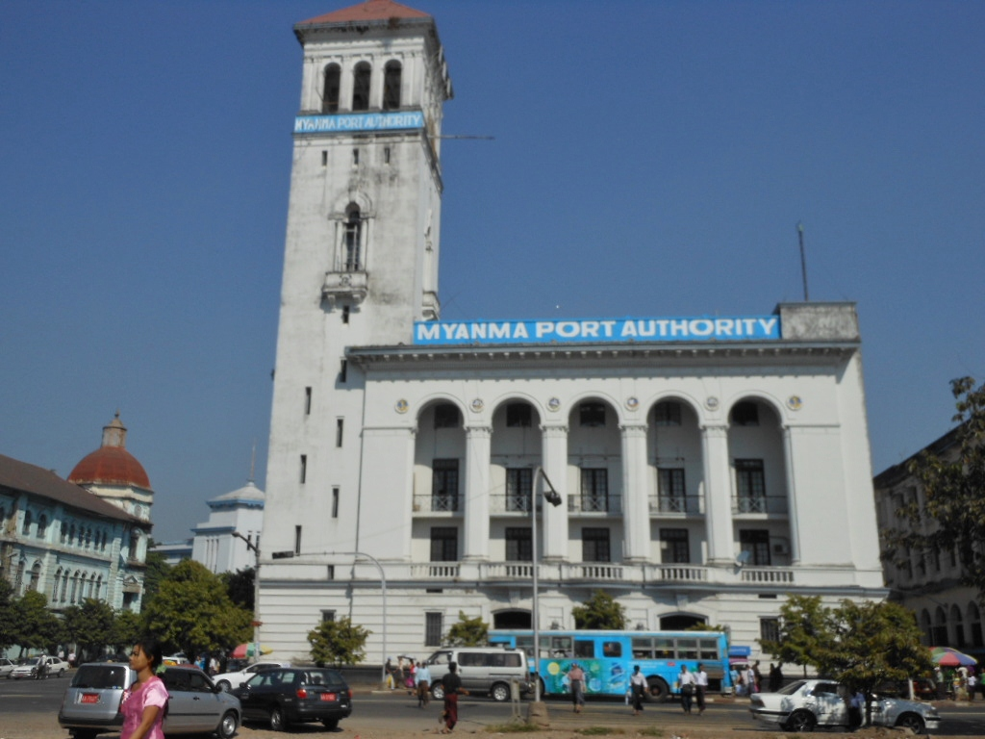
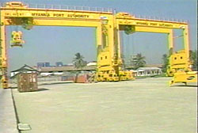
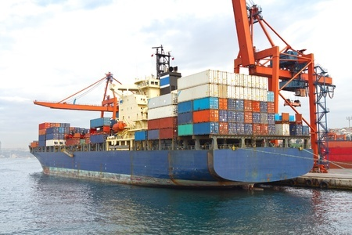
Relevant authorities ‒ Services of MPA
Pilotage
Container and General Cargo Handling and Storage
Diving Service
Tug Service
Shipping Agency Service
Fire Fighting
Port Security
Fresh Water Supply
Ship Repairs

Slide 14
Outline of the Talk
1
Business Structure and Tax
2
Functions of Maritime Authorities
3
Foreign Vessels and Myanmar Waters
4
Environmental Framework and Marine Pollution
5
Labor Obligations

Slide 15
Foreign vessels entering Myanmar waters
Inform Shipping Agency Dept. under MPA
Owner shall send a letter to Shipping Agency Department, indicating
ETA of the ship;
ETD of the ship;
Specification of the cargo;
Shipping particulars, and
Person responsible for shipping charges.
Request compulsory pilot if ship is above 200 GRT.
Shipping Agency Department will return a letter of acceptance.
Shipping Agency Fee is USD 385/ship

Slide 16
Outline of the Talk
1
Business Structure and Tax
2
Functions of Maritime Authorities
3
Foreign Vessels and Myanmar Waters
4
Environmental Framework and Marine Pollution
5
Labor Obligations

Slide 17
Foreign vessels registering in Myanmar
To operate in Myanmar waters, a foreign vessel would need to register in Myanmar.
But, Myanmar is not an “open registry”.
An accepted option is to register a bare boat charter, with dual registration. (Myanmar + foreign registration)
To register the bare boat charter, the ship is required to have a company in Myanmar.
At present, the company would need to be a JV with a Myanmar citizen. *There is the big possibility that this will change in the near future.*

Slide 18
Foreign vessels registering in Myanmar
Foreign ships registering in Myanmar, registration fee is according to tonnage
Up to 5,000 tons ships the registration is approximately USD 10,000 and will increase and decrease according to tonnage.

Slide 19
Crew
Currently, there are foreign supply ships registered as bareboat charters in Myanmar.
The Master and crew are foreigners, however, this will change in the future, where it will be compulsory at operation level to hire Myanmar nationals. This is not in force yet and there will however be a grace period.

Slide 20
Outline of the Talk
1
Business Structure and Tax
2
Functions of Maritime Authorities
3
Foreign Vessels and Myanmar Waters
4
Environmental Framework and Marine Pollution
5
Labor Obligations

Slide 21
Environmental Conservation Law and Rules
Environmental Conservation Law 2012
Environmental Conservation Rules 2014
Environmental Impact Assessment Procedures Bill
Ministry of Environmental Conservation and Forestry Environmental Conservation Committee
Environmental Impact Assessment Review Committee
Additional subordinate legislation in respect of quality standards, listings of hazardous materials and environmental incidents, etc., yet to be drafted.

Slide 22
Reporting obligations for PSC proponents and subcontractors
Must abide by the Environmental Management Plan that has received an “Environmental Compliance Certificate” from the Ministry and Environmental Conservation Committee.
Must collaborate and support Ministry monitoring and investigations of compliance and environmental incidents
The PSC proponent/subcontractor is responsible for all Ministry costs for monitoring and evaluation
Must provide six monthly reports to the Ministry on compliance with EMP

Slide 23
Environmental offences and penalties
Untested environmental protection framework.
It is an offence to deviate from the EMP or to not offer full disclosure in the EIA.
Project proponent must report within 24 hours when there has been a serious environmental incident and within 7 days where there has been an environmental incident likely to have an impact.
Some environmental offences contained in other legislation in respect of waterways and wildlife.
Penalties – prison sentencing of up to 5 years, monetary fines of up to MMK 2 million, compensation for damage, costs of remedy, government costs.

Slide 24
Other international treaties
Myanmar is currently a party to MARPOL Annex I/II and is in the process of becoming a party to Marpol annex III, IV, V which are key instruments for sewage and garbage dumping and other environmental protection.
UNCLOS, 1982(the UN Convention on the Law of the Sea, 1982)
SOLAS (Safety of Life at Sea, 1974 and its amendment of 1978)
Loadlines Convention 66 Tonnage Convention 69 and STCW (Standards of training, certification, watch keeping ).
Myanmar has ratified SUA 1988 Protocol for the Suppression of Unlawful Acts against the Safety of Fixed Platforms Located on the Continental Shelf.
In total, Myanmar a party to 28 international conventions impacting on offshore activities.

Slide 25
Outline of the Talk
1
Business Structure and Tax
2
Functions of Maritime Authorities
3
Foreign Vessels and Myanmar Waters
4
Environmental Framework and Marine Pollution
5
Labor Obligations

Slide 26
Offshore Operators as Employers
Relevant Laws:
Social Security Law 2012
Minimum Wage Law 2012
Immigration Act 1947
Employment and Skill Development Law 2013
Foreign Investment Law 2012
Payment of Wages Act 1936
Leave and Holidays Act 1951

Slide 27
Employment Contracts in Myanmar
A company must enter into written employment contracts with Myanmar citizens and foreign staff within 30 days of commencement of the employment;
Ministry of Labor provides a standard employment contract, which is applicable to all employees, public and private, and shall be deemed to apply in all cases where the employee’s written contract is silent;
Myanmar allows employers and employees to vary the terms of the Standard Employment Contract so long as the variation is not in contravention of Myanmar’s labor and employment laws.

Slide 28
Workforce
In the first two years, 25% of the skilled workforce must be Myanmar citizens, by year four this increases to 50% and by year six this increases to 75%.
Employer must provide training to citizen employees to reach employment demographic targets.
For unskilled jobs only Myanmar citizens can be employed.
“Unskilled” not defined in Myanmar law, but generally understood to mean jobs that require the completion of simple tasks and do not require any training or experience or exercise of independent judgment on behalf of the employee

Slide 29
Thank you
James Finch
Partner,
Managing Director, Naypyidaw Office Myanmar
james.finch@dfdl.com
jamesfinch1023@yahoo.com
29

